Slide 1
Low-Head Hydropower Development at Coon Rapids Dam
NAU HydroJacks
Nathaniel Holguin
Karsten Jones
Anthony Nuzzo
Dawson Stevens

Slide 2
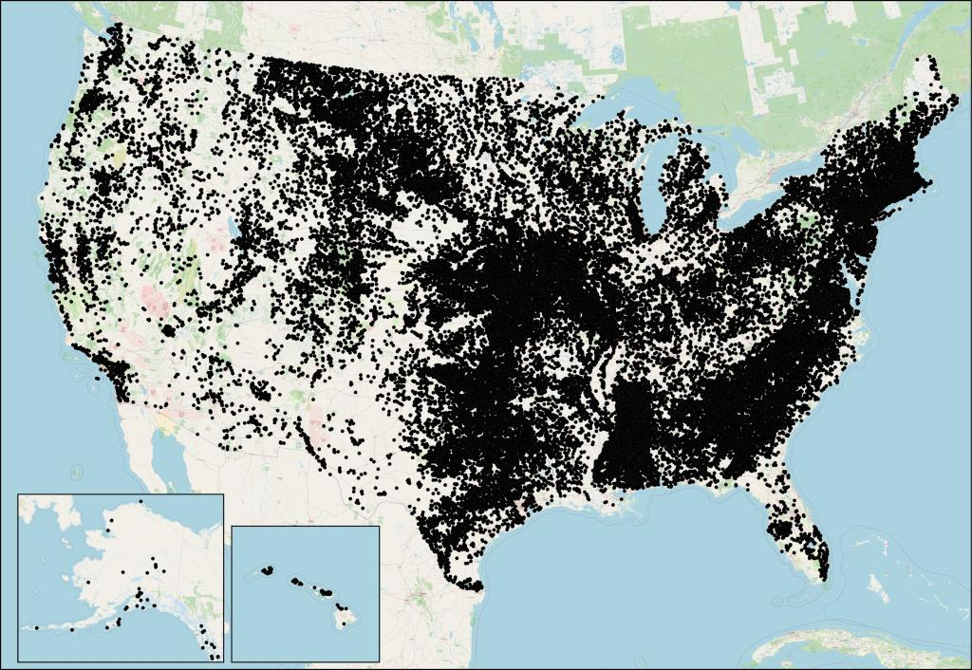
PROBLEM / OPPORTUNITY
80,000+ non-powered dams in the U.S.
Existing infrastructure with untapped energy potential
Growing demand for reliable renewable energy
These sites represent a major opportunity for sustainable energy generation.
We started with a budget of $15,000 for:
Prototyping
Conference travel
Software
Outreach
Locations of non-powered dams is plotted according to data from the National Inventory of Dams. Oak Ridge National Laboratory

Slide 3
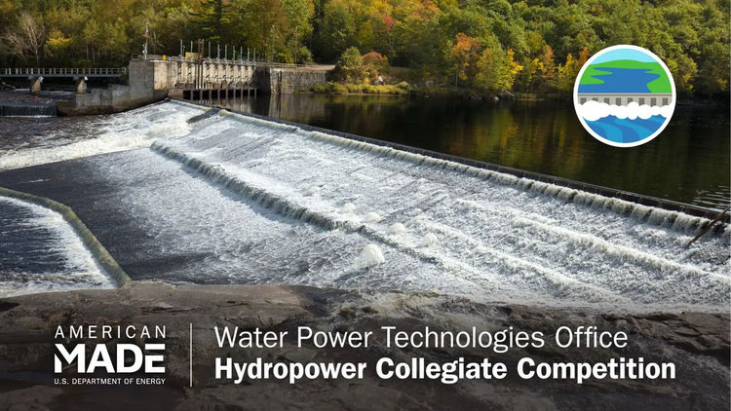
PROJECT DESCRIPTION
Competition Overview
Hydropower design competition focused on real-world energy solutions
Emphasis on feasibility, performance, and impact
Project Scope
Siting Challenge: Select optimal retrofit location
Design Challenge: Develop a functional hydropower system
Community Connections: Engage with industry and stakeholders
Why It Matters
Growing global energy demand
Hydropower = reliable renewable source
Leverages existing infrastructure

Slide 4
DELIVERABLES
ME486C
33% Manufactured / 67% Purchased
67% Manufactured / 100% Purchased
UGRAD's Registration
100% Manufactured
Finalized Testing Plan / Demo
Final CAD / BoM
UGRAD's Symposium
Final Design Report
HCC26 Competition
Weekly Advisor Meetings
Biweekly Industry Mentor Meetings
Mid-year Submissions
Final Report (4/13)
  Siting
  Design
Community Connections Report (4/20)
Build & Test (Competition)
Competition (4/27 - 4/30)

Slide 5
SUCCESS METRICS
Metric | Target | Result | Why it Matters
Installed Generation Capacity | 1-10 MW | 2.17 MW | Proves design is in small hydro range
Levelized Cost Of Energy | $0.08/ kWh | $0.0796 /kWh | Shows system is economically competitive
Flow Availability | >50 m³/s | 90 – 630 m³/s | Reliable resource for generation
Diversion Ratio | 10-25% | 15% | Within permitting constraints
Grid Interconnection Distance | <2 km | .6 km | Shorter distance reduces overall cost and improves feasibility
Capacity Factor | 40-80% | 67% | Well matched configuration to site hydrology

Slide 6
DESIGN REQUIREMENTS
Customer Requirements
CR1 - Reliable Power Supply
CR2 - Structural Integrity
CR3 - Competitive Cost
CR4 - Low Environmental Impact
CR5 - Long Life Expectancy
CR6 - Regulatory Compliance
Engineering Requirements
ER1 - Generation Capacity(1-10MW)
ER2 - LCOE ($.08/kWh± $ .03/kWh)
ER3 - Flow Availability (>40m³/s)
ER4 - Flow Diversion Ratio (10-25%)
ER5 - Grid Connection (<2km)
ER6 - Capacity Factor (40-80)%

Slide 7
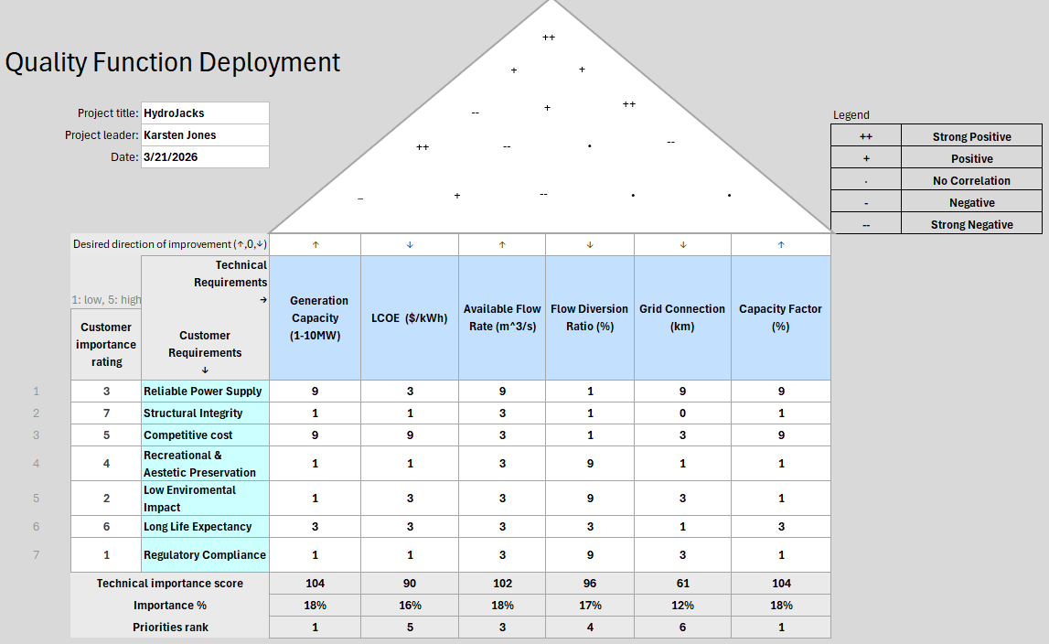
House of Quality (QFD)

Slide 8
BENCHMARKING
(1-low, 5-high) | RedRock | Uniontown | Holtwood
Reliable Power Supply | 5 | 4 | 5
Structural Integrity | 5 | 4 | 4
Competitive cost | 3 | 5 | 4
Recreational & Aesthetic Preservation | 3 | 4 | 4
Low Environmental Impact | 4 | 4 | 4
Long Life Expectancy | 5 | 4 | 4
Regulatory Compliance | 5 | 5 | 4
Redrock Hydroelectric Project [41]
- Added 36 MW capacity to non-powered section.
- Example of Medium NPD conversion
- Reliable power, but high upfront costs.
Uniontown Dam Retrofit [42]
- Added 5 MW capacity.
- Low head run of river example with higher flows, smaller river.
- Modest environmental impact, strong community scale power.
Holtwood Hydro Retrofit [43]
- Added 125 MW capacity-Good Cost benefit, minimal visual footprint.
- Large-scale upgrade with new powerhouse and turbines
- Focus on efficiency improvement and increased generation capacity

Slide 9
LITERATURE REVIEW
Karsten Jones
[8] “Levelized Cost of Energy,” ATB, https://atb.nrel.gov/electricity/2024/definitions (accessed Mar. 1, 2026).
[9] Renewable power generation costs in 2024, https://www.rinnovabili.it/wp-content/uploads/2025/07/IRENA-RENEWABLE-POWER-GENERATION-COSTS-IN-2024.pdf (accessed Mar. 1, 2026).
Anthony Nuzzo
[14] “Hydropower in the Context of Sustainable Energy Supply: A Review of Technologies and Challenges,” ResearchGate. [Online]. Available: https://www.researchgate.net/publication/258404306_Hydropower_in_the_Context_of_Sustainable_Energy_Supply_A_Review_of_Technologies_and_Challenges. [Accessed: 18-Sep-2025]
[18] Federal Energy Regulatory Commission, Hydropower Primer: A Handbook of Hydropower Basics, Office of Energy Projects, Washington, DC, Tech. Rep., Feb. 2017. [Online]. Available: https://www.ferc.gov/sites/default/files/2020-05/hydropower-primer.pdf
Dawson Stevens
[26] Carly Hansen, Juan Gallego Calderon, Camilo Bastidas Pacheco, Cleve Davis, Rohit Mendadhala, Glenn Russell. 2024. Technical Potential for Hydropower Capacity at Nonpowered Dams. Hydrosource. Oak Ridge National Laboratory, Oak Ridge, Tennessee, USA. https://doi.org/10.21951/HydroCapacity_NPD/2570407
[28] “Hydropower development guidelines,” U.S. Department of the Interior, https://www.doi.gov/cupcao/Hydropower (accessed Sep. 18, 2025).
Nathaniel Holguin
[39] P. Cooper, “Coon Rapids Hydroelectric Dam | MNopedia,” Mnhs.org, Oct. 17, 2012. https://www.mnhs.org/mnopedia/search/index/thing/coon-rapids-hydroelectric-dam
[40] U.S. Army Corps of Engineers, “Tombigbee River–John C. Stennis Lock & Dam–Water Control Data,” USACE Reservoir Control, 2025. [Online]. Available: https://rivergages.mvr.usace.army.mil

Slide 10
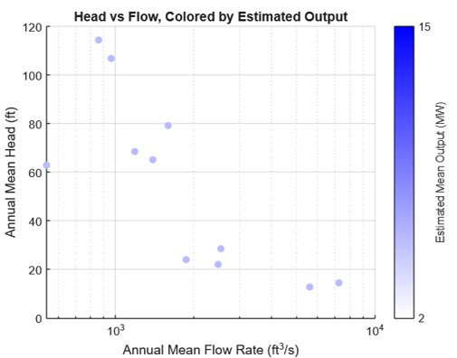
MATHEMATICAL MODELING
Narrowing down the list of potential dams
80,000+ NPDs across the country
Database of ~2500 NPDs with flow rate, head, estimated output, etc.
Used MATLAB to filter out ~1700 of these entries through criteria:
  Maximum Output: 2 < P < 15 MW*
  Min Mean Flow: Q > 400 ft³/s
  Min Mean Monthly Output: E > 1000 MWh
11 Dams fit these conditions
*Higher than 10 MW max since this number assumed 100% efficiency

Slide 11
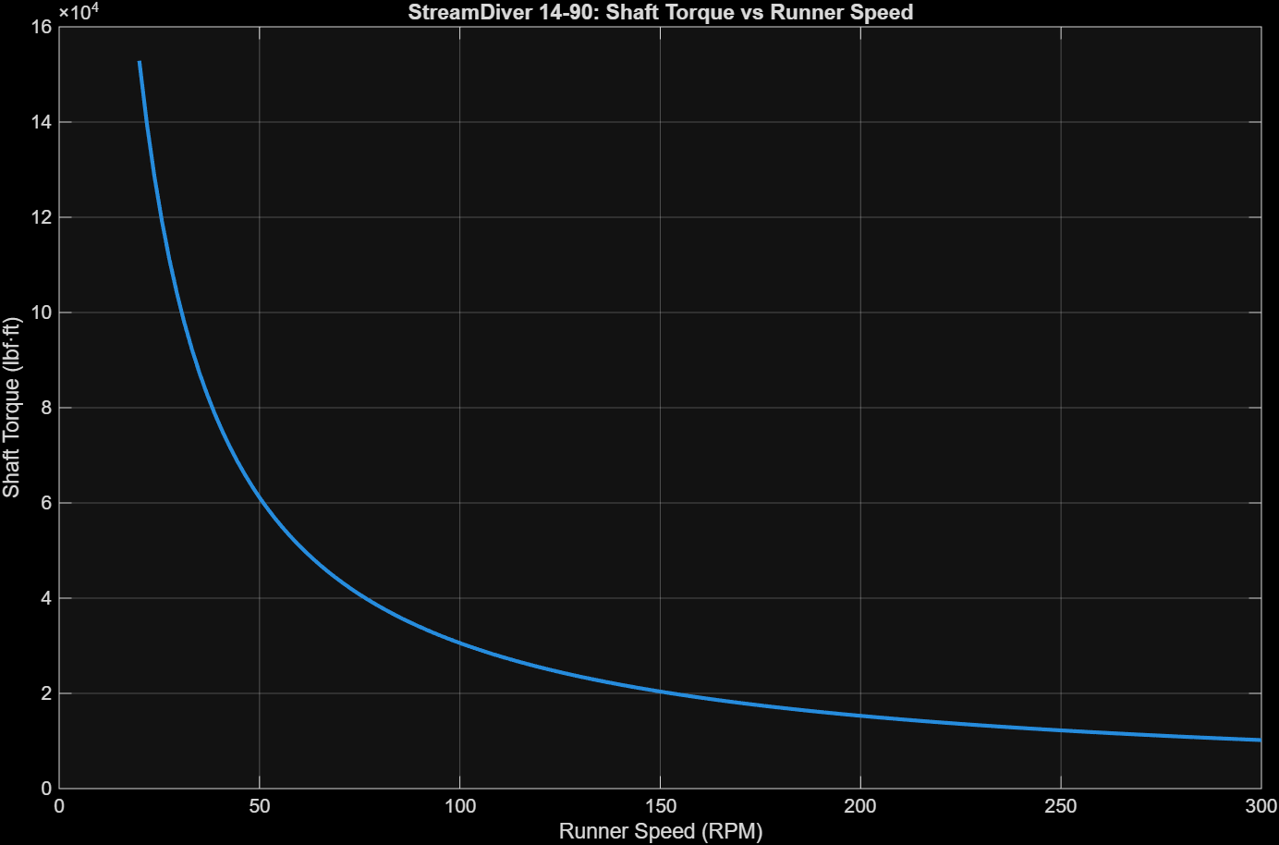
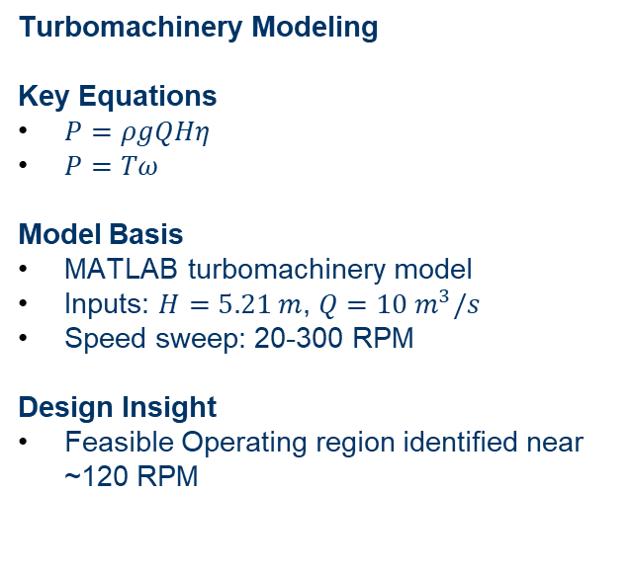
MATHEMATICAL MODELING
Turbomachinery Modeling
Key Equations
$P=ρgQHη$
$P=Tω$
Model Basis
MATLAB turbomachinery model
Inputs: $H=5.21 m$, $Q=10 m^{3}/s$
Speed sweep: 20-300 RPM
Design Insight
Feasible Operating region identified near ~120 RPM

Slide 12
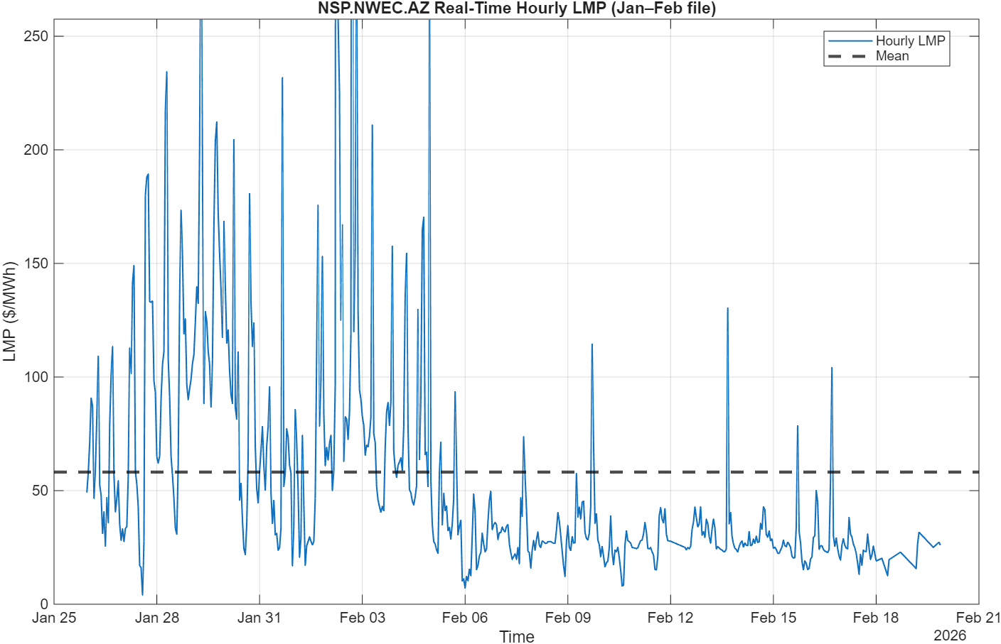
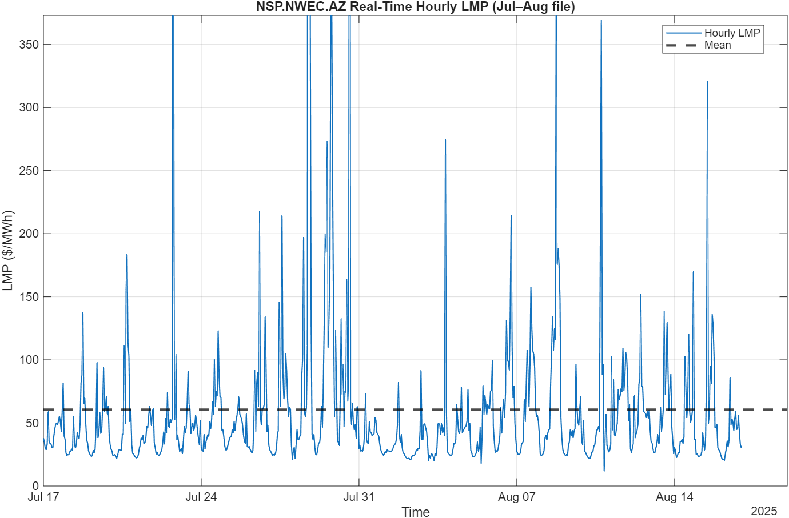
MATHEMATICAL MODELING
-Summer median pricing exceeds winter median
-Winter Scarcity brings high value hours
-Summer peak demand brings consistent pricing

Slide 13
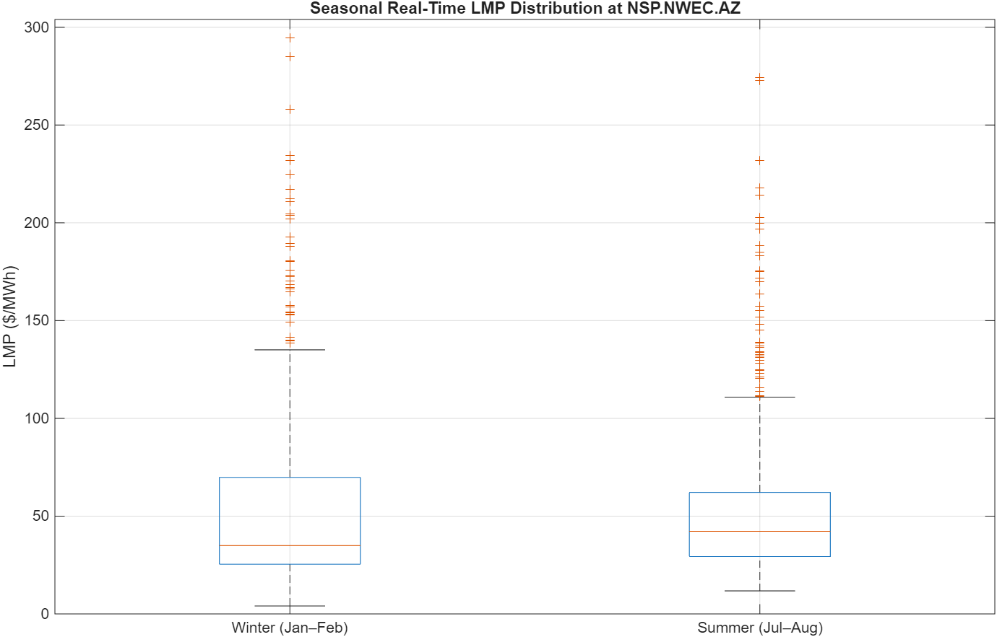

MATHEMATICAL MODELING
Summer median pricing exceeds winter median, indicating stronger typical peak demand value
Winter exhibits higher upper-tail volatility(P95) due to scarcity events
Hydro production aligns with both seasonal peak demand and high-value scarcity hours.

Slide 14
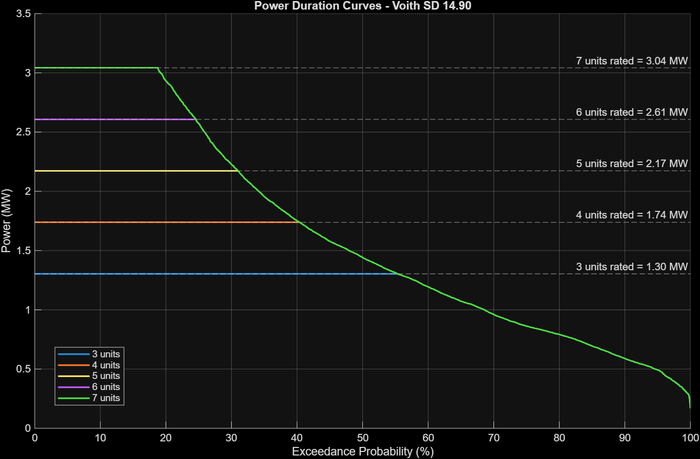
MATHMATECAL MODELING
System Performance
Power output limited by flow availability & turbine capacity
High exceedance → reduced power due to flow constraints
Flat regions → capacity-limited operation
Key Takeaways
Increasing from 3 to 7 units increased installed capacity by 133%
Annual energy only increased by about 48%
Capacity factor dropped about 37%
LCOE increased by about 58%, supporting the decision to implement five turbines.
Selected 5 Turbines
12.70 GWh/year
CF ≈ 0.67 (balanced performance)

Slide 15
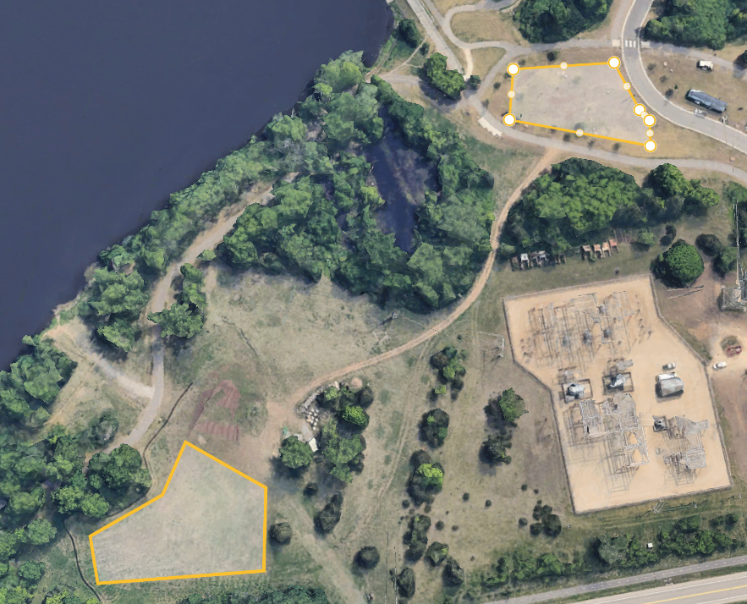
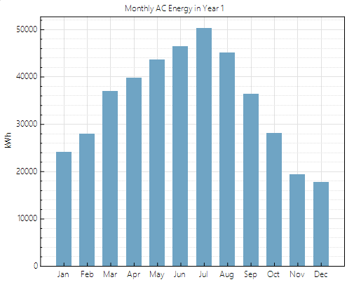
MATHEMATICAL MODELING
Solar Integration
Proposed Site installation Area (~0.9 acres), 575 modules
Installed capacity: 305 kWdc / 250 kWac
Annual generation: 415 MWh/year
Capacity factor: 15.5%
Specific yield: 1,361 kWh/kW-yr
LCOE: ~ 12.2 ¢/kWh
Installed cost: ~ $560k
Peak solar productivity aligns with summer recreational demand and compliments hydropower variability.

Slide 16
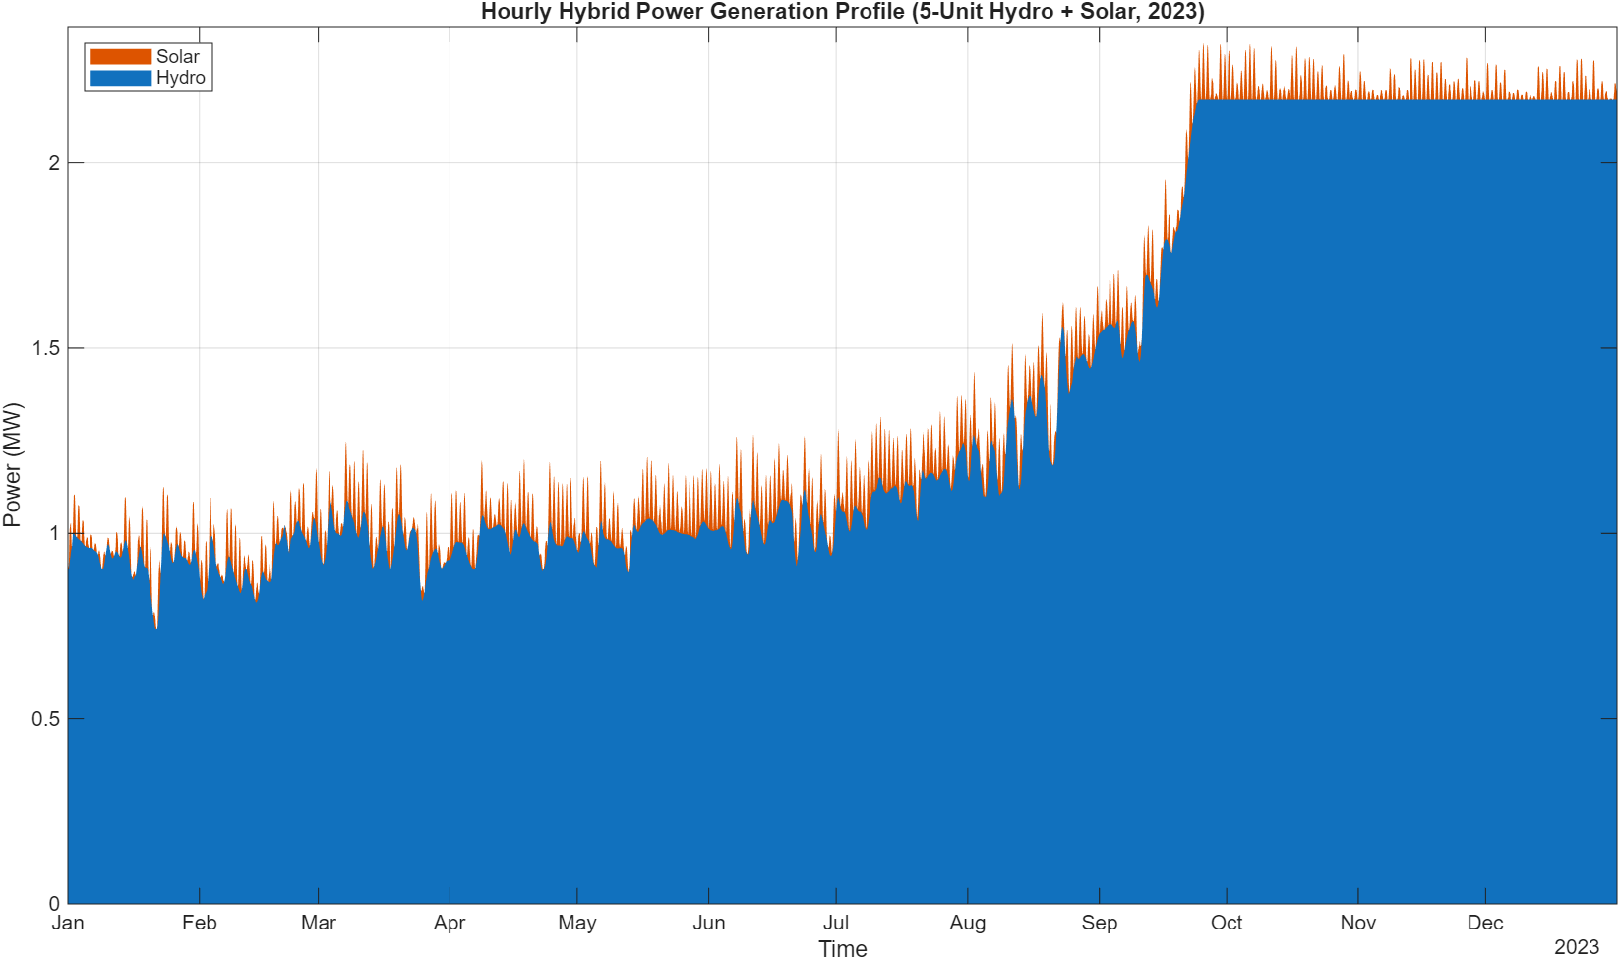
MATHEMATICAL MODELING
Around 1MW from Jan-Aug
Sept-Oct reaches nameplate capacity
Solar copower keeps the system above 1MW
Solar contributes 3.7% of total energy

Slide 17
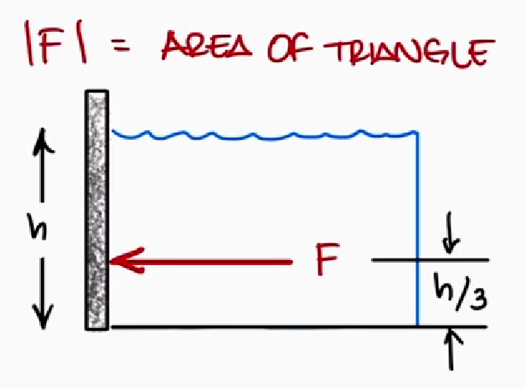
MATHEMATICAL MODELING
How strong of a wall or dam do we need?
Forces and moments pushing on dam as a result of the water
Knowing theses value indicates our reaction forces and moment needed from a wall or gate
Ex:
w = 6 m
h = 3 m
Gives us:
P = 29.43 kPa
F = 270 kN
M = 270 kN*m
Hydrostatic Force, (N) F = ½ P(h) * A | Height/Depth of Dam, h (m)
Hydrostatic Pressure, (Pa) P(h) = ⍴gh | Gravitational Acceleration, 9.81 g (m/s²)
Moment of Force at Base, M = F * (h/3) | Density of Water, 1000 ⍴ (kg/m³)
Area of the Contact/Dam, A (m²) A = w*h | Width of Dam, w (m)

Slide 18
FUNCTIONAL DECOMPOSITION
Capture Flow
Regulate Flow
Extract Energy
Generate Electricity
Deliver to Grid
Intake
Gates /
Diversion
Turbine
Generator
Interconnection
Primary Function: Generate Electricity from Flowing Water

Slide 19
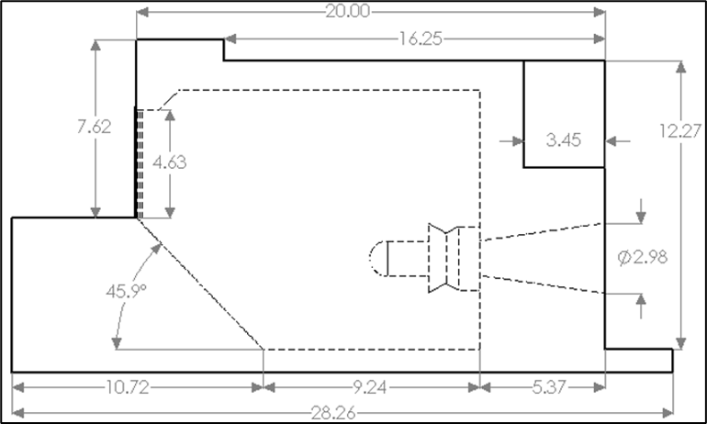
CONCEPT GENERATION
Full Dam Retrofit (SELECTED)
Integrates turbine within existing dam structure
Maximizes use of available head and flow
✓ Highest energy capture potential
✓ Utilizes existing infrastructure footprint
Run-of-River Installation
Minimal structural modification
✖ Lower energy capture
Diversion Channel System
Controlled flow operation
✖ High construction cost and site disruption
Selection Drivers
Maximize energy generation
Minimize new infrastructure footprint
Maintain site feasibility and integration
METERS
IDK what image for this

Slide 20


SELECTION CRITERIA
Estimated Mean Output​
  ORNL NPD Inventory Data​
  Score = P*10 if P < 10​
  Score = 100 if P > 10​
Flow & Head Consistency​
  ORNL NPD Inventory Data​
  Score = 1 – Coefficient of Variance​
Infrastructure Proximity​
  GIS Data​
  Score = 10*(10 – Approximate Distance to nearest power line connection (miles))​
  Score = 100 if connection owned by dam owner​
Ownership & Regulation​
  Based on the availability of information from the dam owner & the local regulations on hydropower​
Dam Structure
  Priority given to dams with a favorable structure to a retrofit. Concrete dams were favored over infill dams.
Risk
  Scores given based off the National Inventory of Dam's risk assessments
Local Need
  EnergySage.com Data
  Score = 50 ± % difference from national average $/kWh

Slide 21
DECISION MATRIX
Criterion | Weight | Peoria Lock & Dam |  | Coon Rapids Dam |  | John C. Stennis
 |  | IL01014 |  | MN00507 |  | MS03056
 |  | Score out of 100 | Weighted Score | Score out of 100 | Weighted Score | Score out of 100 | Weighted Score
Estimated Mean Output | 25% | 45.58 | 11.40 | 100 | 25.00 | 100.00 | 25.00
Flow Rate Consistency (1-CV) | 7.50% | 60.68 | 4.55 | 50.80 | 3.81 | 38.26 | 2.87
Head Consistency (1-CV) | 7.50% | 76.49 | 5.74 | 87.43 | 6.56 | 38.26 | 2.87
Poximity to Infrastructure | 12% | 90 | 10.80 | 100.00 | 12.00 | 90.00 | 10.80
Ownership and Regulation | 12% | 65 | 7.80 | 70.00 | 8.40 | 80.00 | 9.60
Structure | 12% | 70 | 8.40 | 90.00 | 10.80 | 70.00 | 8.40
Risk | 12% | 100 | 12.00 | 67.00 | 8.04 | 67.00 | 8.04
Local Need | 12% | 80 | 9.60 | 28.00 | 3.36 | 28.00 | 3.36
Total | 100% |  | 71.08 |  | 77.97 |  | 70.94
Rank |  | 2 |  | 1 |  | 3

Slide 22
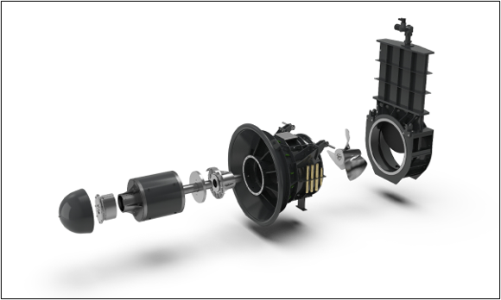

TURBINE SELECTION
Voith StreamDiver 14-90
Intended for small hydro projects
Built-in generator
Built-in stop valve
Small - fits within current dam current powerhouse structure
Minimal operation costs
Low noise impact

Slide 23

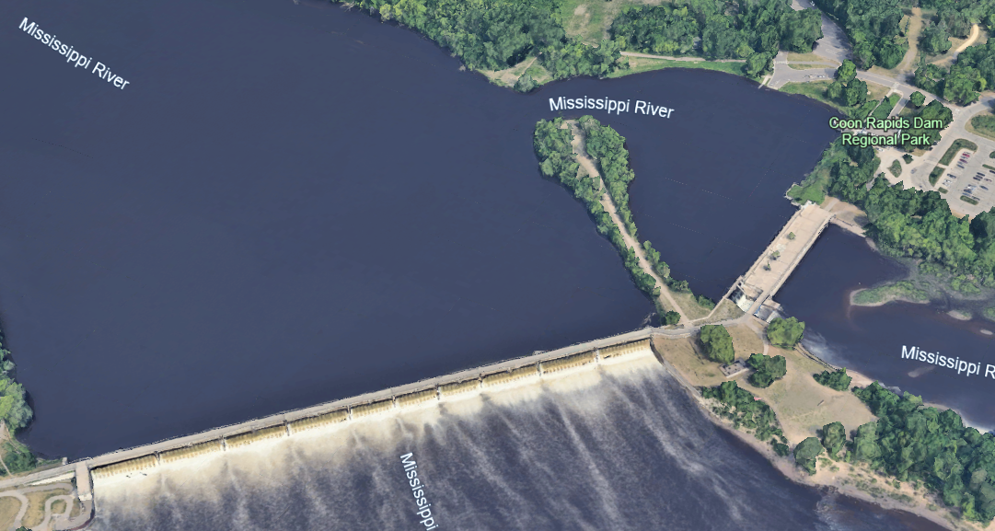
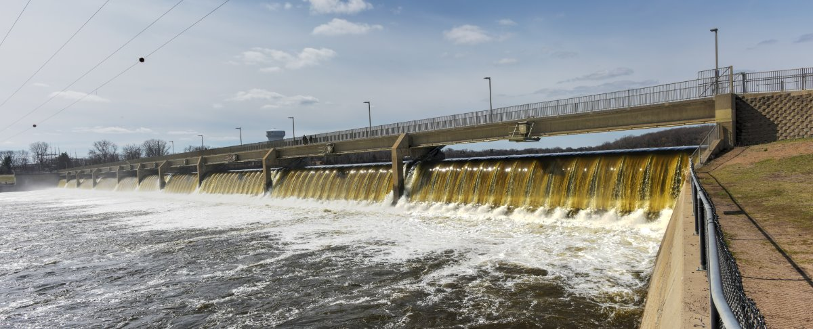
FINAL SITE SELECTION
Coon Rapids Dam
Located in a park in Coon Rapids, Minnesota
Retired Hydropower Dam
  Old turbine housing remains
Currently acts as a barrier against invasive carp
Low-Head, High Flow
  Ideal for small hydro projects
Owned by Three Rivers Park District
Onsite Substation
Acceptable Localized Cost of Energy (LCOE)
Old Powerhouse

Slide 24
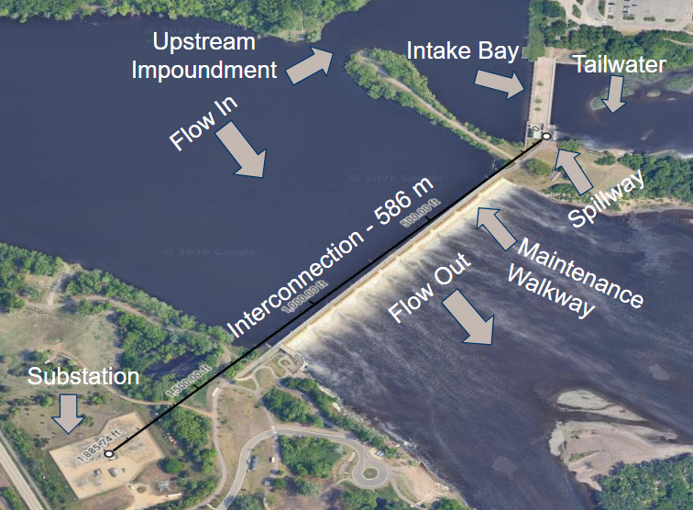
LAYOUT AT DAM

Slide 25
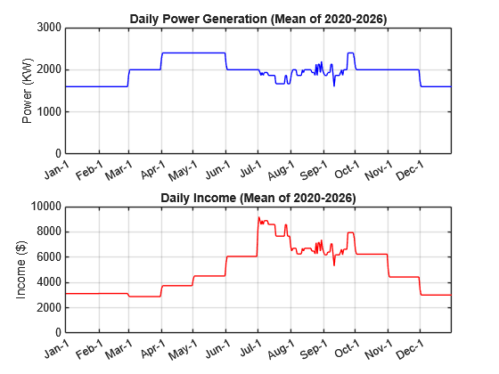
SYSTEM OVERVIEW
Plugging Flow/Head data from 2020-2026 into our MATLAB Simulation*, we predict the following annual output pattern
*Uses given input-output figures from Voith

Slide 26
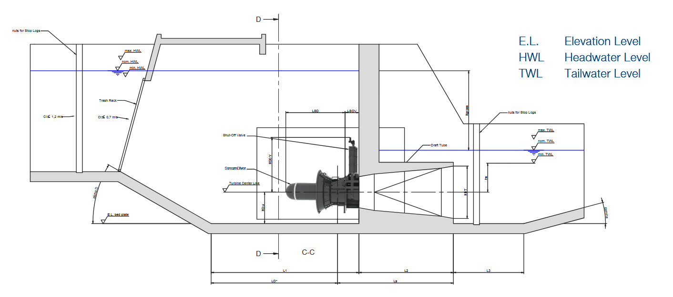
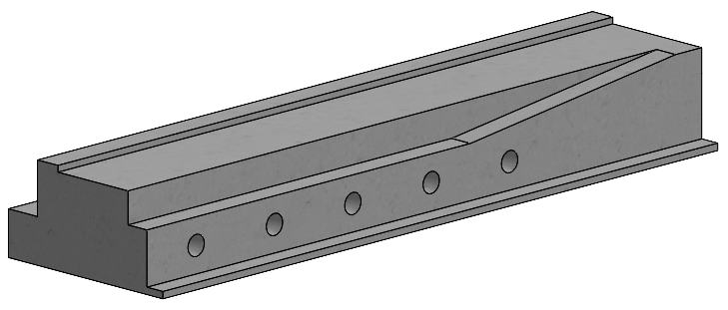
FINAL CONFIGURATION
5 StreamDiver 14-90 Turbine Units
Each unit has a trash rack to prevent debris entry
Modifies the pre-existing turbine housing to fit the turbines
Turbine housing based off the recommended StreamDiver housing

Slide 27
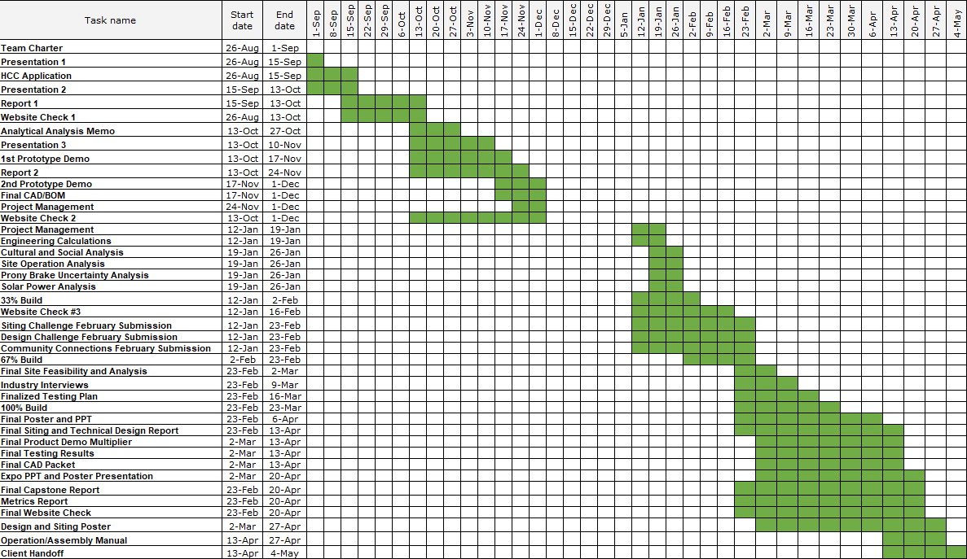
SCHEDULE

Slide 28
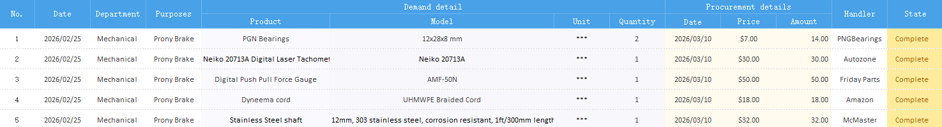

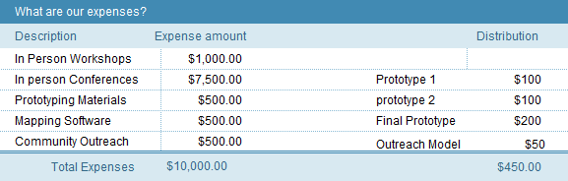
BUDGET

Slide 29
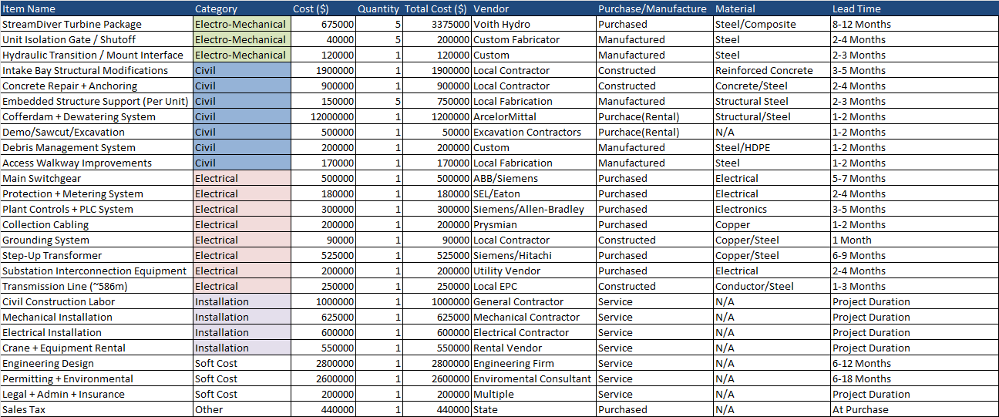
BILL OF MATERIALS

Slide 30
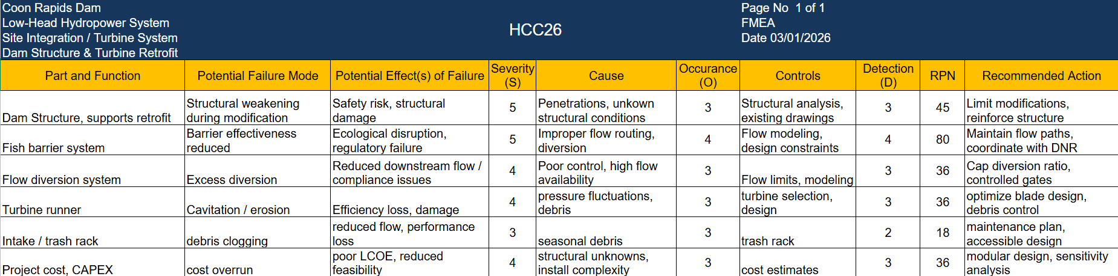
FMEA – DESIGN VALIDATION

Slide 31
PROTOTYPE DESIGN GOALS
Testing Goals:
Understand when the system is most efficient
Understand how water speeds and consistency might actually convert to power
Understanding how much of the turbines power can get converted to actual energy
Procedure:
Measure static length values like turbine and inlet radius
Set up Prony brake and turbine to hydraulic bench
Shoot out water at first speed and collect its speed data
Set up first dead weight to get tension
Shoot water through turbine and collect rotational speed and force
Repeat steps 4-6 for all speeds/weight
Use collected data to measure power and efficiency
Graph collected data to find ideal tension in the system
Torque = (Net Force) * (Turbine Radius)
Power Output = 𝑇orque ∙ Angular Velocity(𝜔)

Slide 32
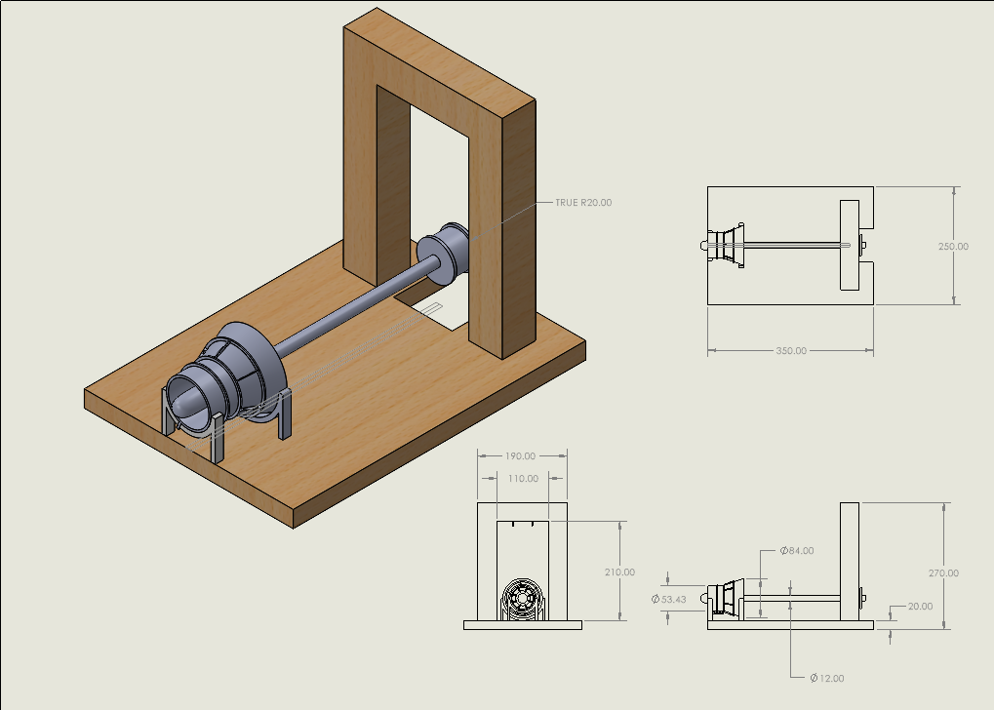
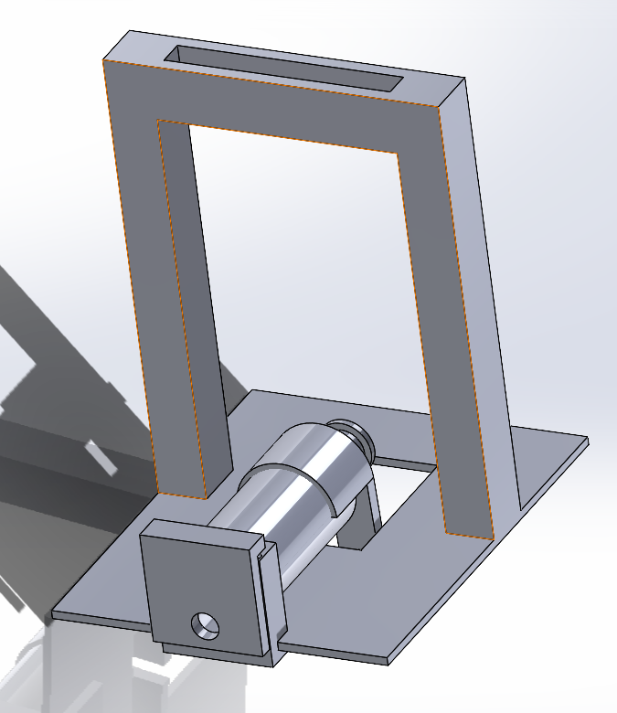
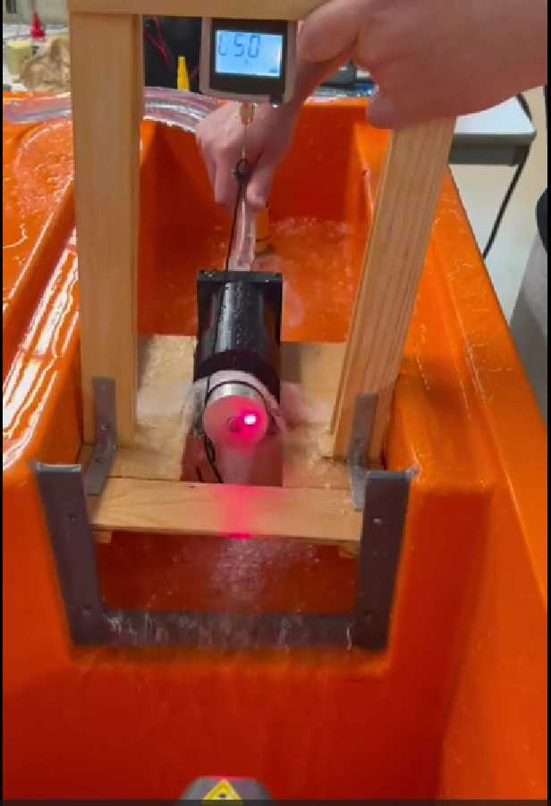
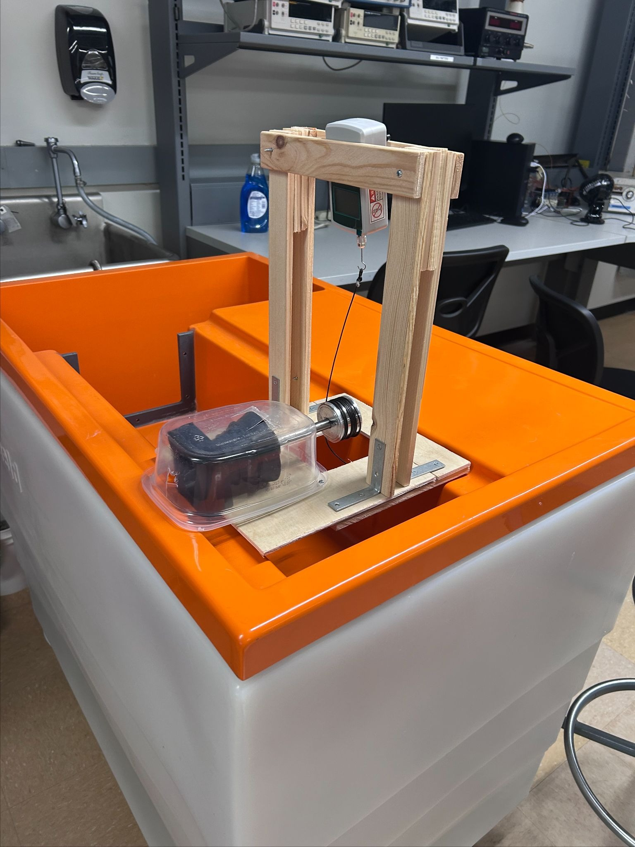
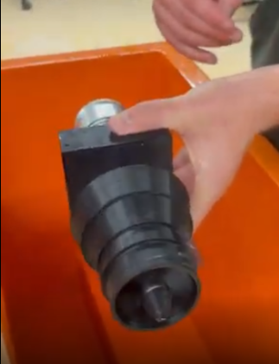
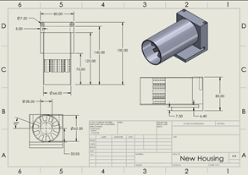
DESIGN ITERATIONS
The design went through 4 total design iterations with the biggest change being the housing for the turbine

Slide 33
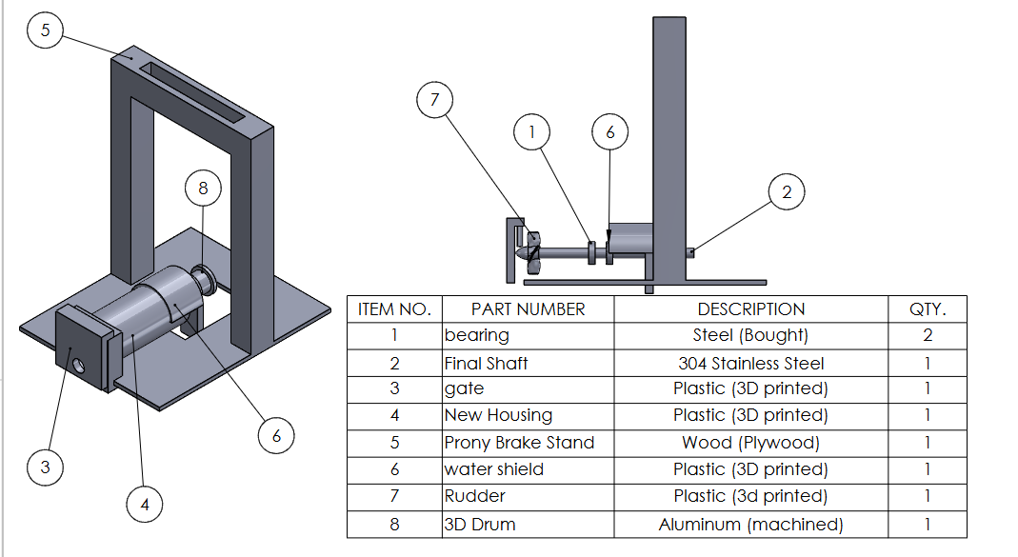
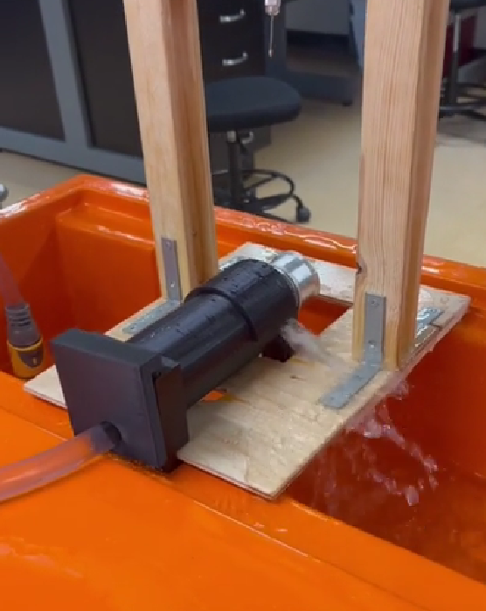
FINAL SYSTEM

Slide 34
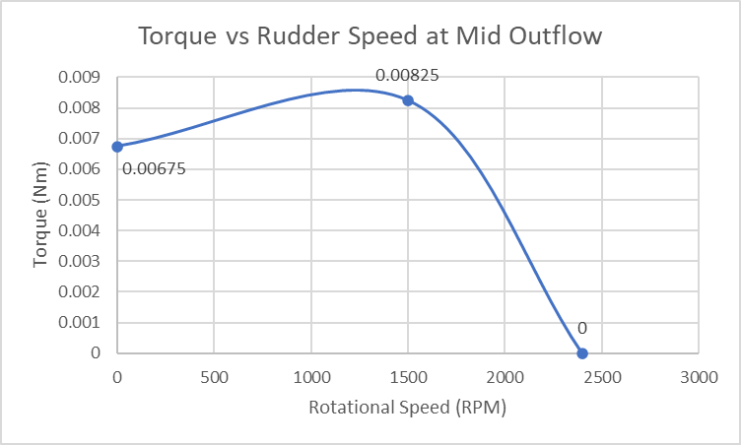
KEY RESULTS
Trial | Water flow | Max Torque | Max Speed | Max Power | Max Efficiency
Test 1 | 0.894 L/s | 0.36 Nm (40g) | 3500 RPM (20g) | 5.42 W (20g) | 24% (20g)
Test 2 | 0.581 L/s | .00825 Nm (20g) | 1500 RPM (20g) | 1.3 W (20g) | 21% (20g)
Test 3 | 0.397 L/s | .0034 Nm (20g) | 200 RPM (20g) | 0.71 W (20g) | 4% (20g)
Data shows the system is most efficient where rotational speed is prioritized rather than torque
Faster water speeds provide much more power and more efficiency
Power curve indicates there is an optimal rotational speed to torque ratio somewhere in the middle of the graph at every water speed

Slide 35
TESTING SUMMARY
Experiment/Test | Relevant DRs | Equipment Needed | Other Resources
Part 1 - Turbine spin/Speed test | -Turbine same model as actual -Turbine fits for experiment -Turbine spins | -Hydraulic bench -Turbine w/ all parts -Tachometer -Force gauge | -Access to Thermal Fluids lab -4 teammates for testing
Part 2 - Prony brake/weight test | -Shaft spins smoothly -Drum collects energy efficiently -Doesn’t fall apart | -Prony brake made by: shaft, drum, wood parts, bearings, 3D print, & rope | -Crafting equipment -Excel spreadsheet to place results
Part 3 - Energy collection | -Transmitter work -Generator collect energy -Battery save and read energy | -Transmitter -Generator -Battery | -Electrical Engineering subteam
Part 4 - Translation to actual analysis | -The turbine behaves in an expected way | -Turbine -Prony brake -Hydraulic bench | -Real world data

Slide 36
ER SPEC SHEET AND TESTING RESULTS
Engineering Requirement | Target | Tolerance | Measured Value | ER Met? (Y/N) | Client Acceptable? (Y/N)
ER1 - Power Output (W) | 1 - 6 W | ± 0.5 W | ~ 5 W | (Y) | (Y)
ER2 - Efficiency (%) | 1 - 50 % | ± 5 % | 1 - 25 % | (Y) | (Y)
ER3 - Flow Rate (L/s) | .1 - 1 L/s | ± .05 L/s | ~.5 L/s | (Y) | (Y)
ER4 - Rotational Speed (RPM) | 100 - 3000 RPM | 95 - 3150 RPM | 200 – 3500 RPM | (Y) | (Y)
ER5 - Torque Output (Nm) | .01 - .150 Nm | .0095 - .1575 Nm | .00825 - .036 Nm | (Y) | (Y)

Slide 37
SITE SPECIFIC CR SPEC SHEET SUMMARY
CR’s | Evaluation Method | CR Met? (Y/N) | Client Acceptable? (Y/N)
CR1 - Reliable Power Supply | Measured power output vs flow rate | (Y) | (Y)
CR2 - Structural Integrity | Assessed through on site concrete review | (Y) | (Y)
CR3 - Competitive Cost | Estimated through LCOE Modeling | (Y) | (Y)
CR4 - Low Environmental Impact | Environmental Impact Study | (Y) | (Y)
CR5 - Long Life Expectancy | Assessed through concrete screening & dam Safety benchmarks | (Y) | (Y)
CR6 - Regulatory Compliance | NEPA,FERC,MNDNR framework implemented in design | (Y) | (Y)

Slide 38
SITE SPECIFIC ER SPEC SHEET SUMMARY
ER’s | Expected Value | Tolerance | Measure/Calculated | ER Met? (Y/N) | Client Acceptable? (Y/N)
ER1 - Generation Capacity | 1-10 MW | none | 2.4 MW | (Y) | (Y)
ER2 - LCOE | $.08/ kWh | ± $.03/ kWh | .0796 $/kWh | (Y) | (Y)
ER3 - Flow Availability | >50 m³/s | - 5 m³/s | Exceeds 90m³/s 90% of the time | (Y) | (Y)
ER4 - Flow Diversion Ratio | 10-25% | None (Licence constraint) | 15% | (Y) | (Y)
ER5 - Grid Connection | <2 km | + .5 km | .6 km | (Y) | (Y)
ER6 - Capacity Factor | 40-80% | ± 5% | 67% | (Y) | (Y)

Slide 39
PERFORMANCE RESULTS
Turbine/Prony Brake:
On initial iterations, turbine did not spin very well
On final iteration, spun smoothly but could not pick up torque and power from the water as much as hoped for
Turbine could not handle as much resistive force/weight as hoped for
Force was able to be collected from force gauge with relative accuracy
RPM was collected efficiently with tachometer
Calculations/Takeaways:
Did not get range of values hoped for
Was still able to collect valuable data though on how a turbine will act in different situations
Actual energy was not able to be collected yet
Faster water speeds/amount is more ideal
More power/efficiency is gathered when in the correct middle ground with respect to water speed
These findings will be used to collect more information in further testing with addition of energy collection
Implementing findings:
When theoretically implementing the turbine system, the electric controller reading RPM could adjust electrical load to maximize power output
Water speeds and consistency is important, so making sure smooth water flow enters the system will maximize long term output
This in unison with a small nozzle to give it that extra velocity would greatly benefit the system as a whole
This matches real Kaplan turbines, designed for low head and high flow environments

Slide 40
ECONOMIC RESULTS
Units | Capacity (MW) | Energy (MWh/yr) | CF | LCOE ($/MWh)
5 | 2.17 | 12,699 | 67% | $79.61
Key Metrics
LCOE: $79.61/MWh
Annual Energy: 12,699 MWh
CAPEX: $10.5M
OPEX: $313,000/year
Capacity Factor: 67% indicates efficient utilization of available flow
Economic Insight
LCOE is competitive with small hydropower systems
Additional turbines increase CAPEX disproportionately
5 turbines achieve optimal cost-to-energy balance
Consistent with small hydropower industry benchmarks
Begins profiting in ~10 years

Slide 41
ENERGY PRODUCTION AND RESIDENTIAL IMPACT
Parameter | Installed Capacity (MW) | Capacity Factor (%) | Annual Energy Production (MWh/yr) | Annual Energy Production (kWh/yr) | Avg. MN Household Consumption (kWh/yr) | Equivalent homes Powered
Hydro | 2.17 | 67 | 12,699 | 12,699,000 | 8,544 | 1,490
Solar | .25 | 15.5 | 480 | 480,000 | 8,544 | 56
Hybrid | 2.42 | 61.9 | 13,479 | 13,479,000 | 8,544 | 1,546
To conceptualize the system's total energy output, the annual generation of 13,479 MWh was compared to the average residential electricity consumption in Minnesota
Based on average household usage of 712 kWh per month (8,544 kWh annually), the proposed hydropower system is capable of supplying energy to approximately 1,550 homes per year as shown in the table above.

Slide 42
FEASIBILITY CONCLUSION
Technical Feasibility
Achieves 2.17 MW capacity (within 1–10 MW target)
~120 RPM operating region (model-validated)
67% capacity factor indicates strong flow utilization
Compatible with low-head (~5.21 m) site conditions
Economic Feasibility
LCOE: $79.61/MWh (competitive)
CAPEX and OPEX within small hydropower norms
Strong annual energy output (~12,699 MWh)
Demonstrates viable cost-to-energy balance
Site & Regulatory Feasibility
15% diversion ratio within environmental limits
0.6 km grid connection minimizes cost
Utilizes existing dam infrastructure
Meets key regulatory and stakeholder constraints
The proposed system is technically, economically, and environmentally feasible for implementation at Coon Rapids Dam.

Slide 43
FUTURE WORK
Detailed Design & Engineering
Finalize turbine and generator specifications
Perform detailed structural and hydraulic analysis
Develop full CAD and construction drawings
Scale-Up & Validation
Transition from lab scale prototype to full scale system
Validate performance under real river flow conditions
Compare full scale behavior to modeled predictions
Permitting & Implementation
Initiate FERC and environmental permitting process
Coordinate with stakeholders (DNR, park, utilities)
Develop construction and installation plan
Economic Refinement
Refine CAPEX / OPEX using vendor and contractor quotes
Perform sensitivity analysis on flow variability and pricing
Evaluate long-term operation and maintenance cost

Slide 44
CONCLUSION
Project Summary
Developed a 2.17 MW hydropower system at Coon Rapids Dam
Designed a full dam retrofit with 5 turbine units
Leveraged existing infrastructure for renewable energy generation
Key Results
LCOE: 79.61/MWh (competitive)
Capacity Factor: 67% (efficient utilization)
Annual Energy: ~12,699 MWh
Meets all major engineering and project requirements
Impacts
Demonstrates potential of non-powered dam retrofits
Provides a scalable, sustainable energy solution
Balances technical, economic, and environmental feasibility
This project demonstrates a viable pathway for converting existing infrastructure into reliable, renewable energy generation.

Slide 45
LITERATURE REVIEW / REFERENCES
Core Insights – Non-powered dams offer significant untapped energy potential
[1] C. Hansen, “Technical potential for hydropower capacity at non-powered dams,” Oak Ridge National Laboratory, https://impact.ornl.gov/en/datasets/technical-potential-for-hydropower-capacity-at-non-powered-dams/ (accessed Sep. 8, 2025).
[2] Hydropower vision report, https://www.energy.gov/sites/prod/files/2018/02/f49/Hydropower-Vision-021518.pdf (accessed Sep. 20, 2025).
[3] “Low-Head Dam Inventory,” Low-head dams inventory, https://nid.sec.usace.army.mil/lhdi (accessed Oct. 15, 2025).
[4] Hydropower primer a handbook of Hydropower Basics, https://www.ferc.gov/sites/default/files/2020-05/hydropower-primer.pdf (accessed Sep. 13, 2025).
Turbine / Design – Turbine selection strongly impacts efficiency and performance
[5] O. Paish, Small hydro power: Technology and current status, https://www.sciencedirect.com/science/article/abs/pii/S1364032102000060 (accessed Sep. 28, 2025).
[6] S. J. Williamson, Low head pico hydro turbine selection using a multi-criteria analysis, https://scholar.google.com/scholar_lookup?title=Low+head+pico+hydro+turbine+selection+using+a+multi-criteria+analysis&amp=&author=S.+J.+Williamson&amp=&author=B.+H.+Stark&amp=&author=J.+D.+Booker&amp=&publication_year=2014&amp=&journal=Renewable+Energy&amp=&pages=43-50&amp=&doi=10.1016/j.renene.2012.06.020 (accessed Oct. 5, 2025).
[7] A. Nasir, E. Dribssa, and M. Girma, “The pump as a turbine: A review on performance prediction, Performance Improvement, and Economic Analysis,” Heliyon, https://pmc.ncbi.nlm.nih.gov/articles/PMC10881369/ (accessed Sep. 1, 2025).
Economics – LCOE depends on flow consistency and capital costs
[8] “Levelized Cost of Energy,” ATB, https://atb.nrel.gov/electricity/2024/definitions (accessed Mar. 1, 2026).
[9] Renewable power generation costs in 2024, https://www.rinnovabili.it/wp-content/uploads/2025/07/IRENA-RENEWABLE-POWER-GENERATION-COSTS-IN-2024.pdf (accessed Mar. 1, 2026).
[10] “Mississippi R. Abv. Coon Rapids Dam in Coon Rapids,” Mississippi R. Abv. Coon Rapids Dam IN Coon Rapids - USGS Water Data for the Nation, https://waterdata.usgs.gov/monitoring-location/USGS-05288400/ (accessed Feb. 20, 2026).

Slide 46
LITERATURE REVIEW / REFERENCES
[11] “Hydro Power,” Student Energy. [Online]. Available: https://studentenergy.org/source/hydro-power/?gad_source=1&gad_campaignid=1654243094&gbraid=0AAAAADmfXHS1brvcEmdjhgh3Bh2-BE8sS&gclid=Cj0KCQjw8p7GBhCjARIsAEhghZ23280bp7kIy7zclB55_iTuTpQ5LtD_TIJClYEDh73TYyiz8Kvf5HUaAuJ1EALw_wcB. [Accessed: 18-Sep-2025].
[12] P. Chapallaz, Manual on Pump Used as Turbine. [Online]. Available: https://www.scribd.com/document/408962857/Chapallaz-Manual-on-Pump-used-as-Turbine-pdf. [Accessed: 18-Sep-2025].
[13] L. W. Mays, Water Resources Engineering, Wiley, 2010. [Online]. Available: https://dl.watereng.ir/doc/Larry%20W.%20Mays%20-%20Water%20Resources%20Engineering%20_2010,%20Wiley_.pdf. [Accessed: 18-Sep-2025].
[14] “Hydropower in the Context of Sustainable Energy Supply: A Review of Technologies and Challenges,” ResearchGate. [Online]. Available: https://www.researchgate.net/publication/258404306_Hydropower_in_the_Context_of_Sustainable_Energy_Supply_A_Review_of_Technologies_and_Challenges. [Accessed: 18-Sep-2025].
[15] “Article — ScienceDirect,” ScienceDirect. [Online]. Available: https://www.sciencedirect.com/science/article/pii/S1364032102000060. [Accessed: 18-Sep-2025].[6] J. P.
[16] Ficalora and L. Cohen, Quality Function Deployment and Six Sigma: A QFD Handbook, 2nd ed., Upper Saddle River, NJ: Prentice Hall, 2010. OBNB+2Penn State University Libraries Catalog+2
[17] Q. A. Okang, T. H. Bakken, and A. Bor, “Investigation of the Hydroelectric Development Potential of Nonpowered Dams: A Case Study of the Buyuk Menderes River Basin,” Water, vol. 15, no. 4, article 717, pp. –, Feb. 11, 2023, doi:10.3390/w15040717.
[18] Federal Energy Regulatory Commission, Hydropower Primer: A Handbook of Hydropower Basics, Office of Energy Projects, Washington, DC, Tech. Rep., Feb. 2017. [Online]. Available: https://www.ferc.gov/sites/default/files/2020-05/hydropower-primer.pdf
[19] If dam sediment is contaminated, all cleanup operations must comply with OSHA's Hazardous Waste Operations and Emergency Response (HAZWOPER) standards (29 CFR 1926.65)
[20] U.S. Energy Information Administration, “Electric Sales, Revenue, and Average Price, Table 5A: Residential Average Monthly Bill by Census Division and State, 2024,” Oct. 2025. [Online]. Available:2024 Average Monthly Bill- Residential
Most notable content
Properties of turbine qualities and aspects.
Considerations when beginning a hydroelectric project.
Environmental considerations for NPD retrofits
Sustainability optimization methods

Slide 47
LITERATURE REVIEW / REFERENCES
[21] G. Gemperline and C. Crane, “Hydraulic Design,” in Guidelines for Design of Intakes for
Hydroelectric Plants, New York, NY: American Society of CIvil Engineers, pp. 16–105
[22] F. Kreith and J. F. Kreider, “Economics of Energy Generation and Conservation Systems,” in
Principles of Sustainable Energy, Boca Raton, Florida: CRC Press, 2011, pp. 65–115
[23] V. Nelson and K. Starcher, “Water,” in Introduction to Renewable Energy Second Edition, Boca
Raton, Florida: CRC Press, 2016, pp. 279–311
[24] E. Broch, D. K. Lysne, N. Flatabo, and E. Helland-Hansen, “Dam safety and risk analysis,” in
Hydropower ’97, Rotterdam/Brookfield: A.A. Balkema, 1997, pp. 349–551
[25] C. C. Warnick, “Hydraulics of Hydropower,” in Hydropower Engineering, Englewood Cliffs, NJ:
Prentice-Hall Inc., 1984, pp. 24–37
[26] Carly Hansen, Juan Gallego Calderon, Camilo Bastidas Pacheco, Cleve Davis, Rohit Mendadhala,
Glenn Russell. 2024. Technical Potential for Hydropower Capacity at Nonpowered Dams.
Hydrosource. Oak Ridge National Laboratory, Oak Ridge, Tennessee, USA.
https://doi.org/10.21951/HydroCapacity_NPD/2570407
[27] L. Monition, M. Le Nir, and J. Roux, “Electromechanical Equipment,” in Micro Hydroelectric Power
Stations, Paris: Wiley-Interscience, 1984, pp. 71–121
Standards:
[28] “Hydropower development guidelines,” U.S. Department of the Interior,
https://www.doi.gov/cupcao/Hydropower (accessed Sep. 18, 2025).
[29] V. J. Zipparro, H. Hasen, and C. V. Davis, Davis’ Handbook of Applied Hydraulics. New York:
McGraw-Hill, 1993.
[30] The Guide to Hydropower Mechanical Design--Prepared by the American Society of Mechanical
Engineers Hydro Power Technical Committee--1996. Kansas City, MO: HCI Publications, 1996.
Topics Include:
● Mathematical modeling and
design
● Economics of energy
● Industry overviews
● Safety Analysis

Slide 48
LITERATURE REVIEW
[31] “Hydropower Program,” Energy.gov. https://www.energy.gov/eere/water/hydropower-program
[32] “Reports & Statistics,” NamUs. https://namus.nij.ojp.gov/library/reports-and-statistics
[33] “HYDROSTATIC PRESSURE (Fluid Pressure) in 8 Minutes!,” www.youtube.com. https://www.youtube.com/watch?v=3MvRpp7WnK0
[34] Fluids Explained, “Force and Moment on a Submerged Surface (Dam) Example,” YouTube, Mar. 27, 2018. https://www.youtube.com/watch?v=lQPDAdgdFkk (accessed Sep. 18, 2025)
[35] S. Insights, “Explore the Top 10 Hydropower Trends in 2023,” StartUs Insights, Mar. 13, 2023. https://www.startus-insights.com/innovators-guide/hydropower-trends/
[36] “Water Power Technology - Littoral Power - Revolutionizing Water Power Technology Waterpower Done Right,” Littoral Power, Feb. 20, 2024. https://littoralpower.com/ (accessed Sep. 18, 2025).
[37] BYJU's, “Hydrostatic Pressure - Definition, Formula, Derivation, Problems,” BYJUS. https://byjus.com/physics/hydrostatic-pressure/
[38] The, “The Basement Doctor of Cincinnati,” The Basement Doctor of Cincinnati, Dec. 03, 2021. https://www.basementdoctorcincy.com/about-us/news-events/41175-5-warning-signs-that-hydrostatic-pressure-is-taking-its-toll-on-your-foundation.html (accessed Sep. 19, 2025).
[39] P. Cooper, “Coon Rapids Hydroelectric Dam | MNopedia,” Mnhs.org, Oct. 17, 2012. https://www.mnhs.org/mnopedia/search/index/thing/coon-rapids-hydroelectric-dam
[40] U.S. Army Corps of Engineers, “Tombigbee River–John C. Stennis Lock & Dam–Water Control Data,” USACE Reservoir Control, 2025. [Online]. Available: https://rivergages.mvr.usace.army.mil
Main Categories of info:
Current Hydropower systems, statistics, and trends
Hydrostatic force and pressure acting on a dam
Preexisting dam site where site selection is on a powered system

Slide 49
References
Benchmarking Sources
[41] “Red Rock Hydroelectric Project: A Model for the future of Clean Energy,” National Hydropower Association, https://www.hydro.org/powerhouse/article/red-rock-hydroelectric-project-a-model-for the-future-of-clean-energy/ (accessed Oct. 20, 2025).
[42] Hydropower Supply Chain Deep Dive Assessment, https://www.energy.gov/sites/default/files/2024-12/Hydropower%2520Supply%2520Chain%2520Report%2520-%2520Final%5B1%5D.pdf Supply Chain Report - Final.pdf (accessed Oct. 20, 2025).
[43] “Lihi Certificate #116 – holtwood hydroelectric project, Pennsylvania: Low impact hydropower,” Low Impact Hydropower | Hydropower Certification, https://lowimpacthydro.org/lihi-certificate-116- holtwood-hydroelectric-project-pennsylvania/ (accessed Oct. 20, 2025).

Slide 50
THANK YOU!

